Slide 1
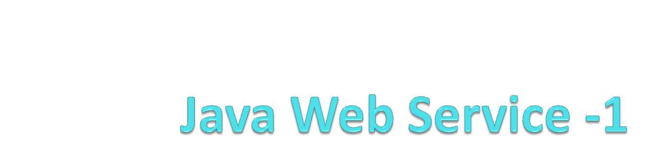

Slide 2
Web-services
Definition:
  “A Web service is a method of communication between two electronic devices over the World Wide Web.”
  Wikipedia
  Web service is "a software system designed to support interoperable machine-to-machine interaction over a network.“
  W3C

Slide 3
Web-services
Definition:
  A Web service has an interface described in a machine-processable format (specifically Web Services Description Language, aka WSDL).
  Other systems interact with the Web service in a manner prescribed by its description using SOAP messages, typically conveyed using HTTP with an XML serialization in conjunction with other Web-related standards.

Slide 4
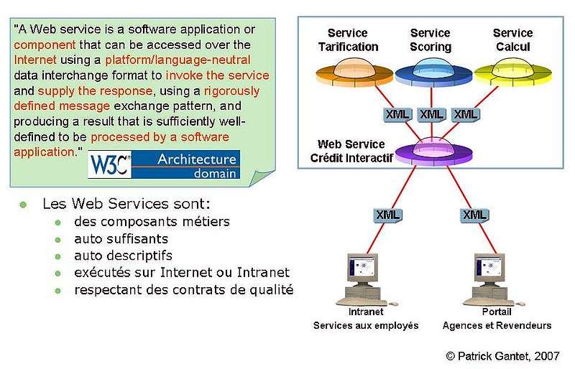

Service-Oriented Achitecture

Slide 5
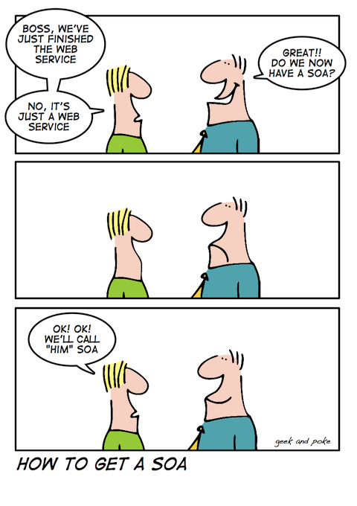
Service-Oriented Achitecture
SOA is a set of principles and methodologies for designing and developing software in the form of interoperable services.
These services are well-defined business functionalities that are built as software components that can be reused for different purposes.

Slide 6
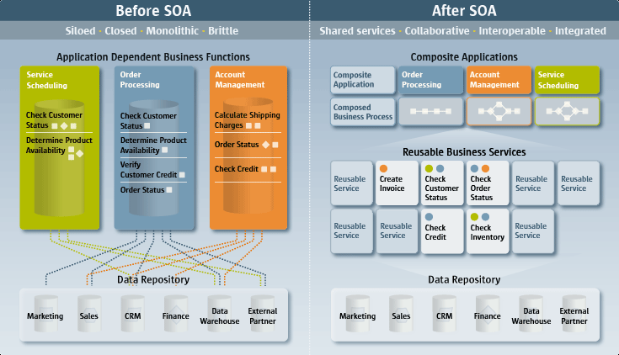
SOA Example

Slide 7
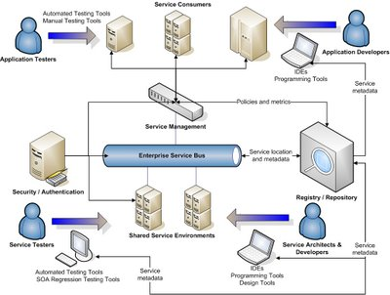
SOA example

Slide 8
Web-services
Definition:
  W3C has identified 2 major classes of Web services
    REST-compliant Web services
      the primary purpose of the service is to manipulate XML representations of Web resources using a uniform set of stateless operations;
      It’s the Web (2.0) API
        a defined set of HTTP request messages along with a definition of the structure of response messages, typically expressed in JSON or XML.
    Arbitrary Web services
      the service may expose an arbitrary set of operations

Slide 9
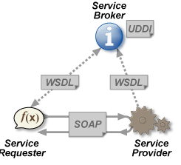
SOAP Web-services
See http://en.wikipedia.org/wiki/SOAP

Slide 10
REST Web-services
REST: Representational State Transfert
  is a style of software architecture for distributed systems such as the WWW.
REST has emerged as a predominant Web-service design model.
REST was first described by Roy Fielding in 2000.
It’s a resource-oriented Web-service

Slide 11
REST Web-services
Architecture definition
  In a REST based architecture everything is a resource. A resource is accessed via a common interface based on the HTTP standard methods.
  In a REST based architecture you typically have
    a REST server which provides access to the resources
    and a REST client which accesses and modify the REST resources.
  REST is designed to use a stateless communication protocol, typically HTTP.
  REST allows that resources have different representations, e.g. text, xml, json etc. The rest client can ask for specific representation via the HTTP protocol (content negotiation).

Slide 12
REST Web-services
HTTP methods
  GET defines a reading access of the resource without side-effects. The resource is never changed via a GET request, e.g. the request has no side effects (idempotent).
  PUT creates a new resource, must also be idempotent.
  DELETE removes the resources. The operations are idempotent, they can get repeated without leading to different results.
  POST updates an existing resource or creates a new resource.

Slide 13
REST Web-services
Example
  base URI for the web service: http://example.com/resources/
Resource | GET | PUT | POST | DELETE
Collection URI, such as http://example.com/resources/ | List the URIs and perhaps other details of the collection's members. | Replace the entire collection with another collection. | Create a new entry in the collection. The new entry's URL is assigned automatically and is usually returned by the operation. | Delete the entire collection.
Element URI, such as http://example.com/resources/item17 | Retrieve a representation of the addressed member of the collection, expressed in an appropriate Internet media type. | Replace the addressed member of the collection, or if it doesn't exist, create it. | Not generally used. Treat the addressed member as a collection in its own right and create a new entry in it. | Delete the addressed member of the collection.

Slide 14
JAX-RS API
Specifications
  Annotations to aid in mapping a resource class (a Plain Old Java Object) as a web resource.
    @Path specifies the relative path for a resource class or method.
    @GET, @PUT, @POST, @DELETE and @HEAD specify the HTTP request type of a resource.
    @Produces specifies the response MIME media types.
    @Consumes specifies the accepted request media types.
  Annotations to method parameters to pull information out of the request. All the @*Param annotations take a key of some form which is used to look up the value required.
    @PathParam binds the parameter to a path segment.
    @QueryParam binds the parameter to the value of an HTTP query parameter.
    @MatrixParam binds the parameter to the value of an HTTP matrix parameter.
    @HeaderParam binds the parameter to an HTTP header value.
    @CookieParam binds the parameter to a cookie value.
    @FormParam binds the parameter to a form value.
    @DefaultValue specifies a default value for the above bindings when the key is not found.
    @Context returns the entire context of the object. Ex.(@Context HttpServletRequest request)

Slide 15
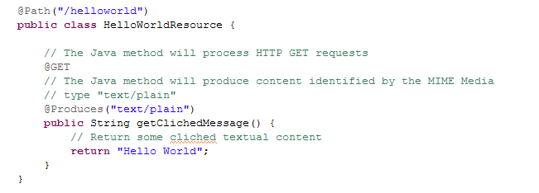
JAX-RS API

Slide 16
JAX-RS implementations
Implementations
  Apache, CFX from Apache
  Jersey, from Sun/Oracle (J2EE 6 reference implementation)
  RESTeasy, from Jboss
  Restlet, created by Jerome Louvel, a pioneer in REST frameworks.
  …

Slide 17
Keywords
WSDL
@QueryParam
XML
SOAP
JAX-RS
@POST
@Path
REST
@GET
stateless
@PUT
@DELETE

Slide 18
Thank You..

